Slide 1

Do these Chemicals Contribute to a Disease?
Theresa Cervantes
Notes:
Whether we can predict if a chemical causes diseases using text data.

Slide 2
Why should we care?
Notes:
Take guesswork out of care-giving
How are we going to do it? Well, let me show you.

Slide 3
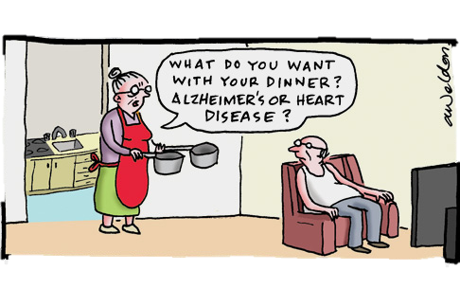
Table of Contents: - Topic modeling - Classification
Let’s first get some data...
Notes:
What are the hot topics that medical researchers are writing about?
The actual prediction.
Between yes, this chemical contributes to a disease
or
no, it doesn't.

Slide 4

The receptors to 5-HT6 are related to psychotic disorders, not 5-HT itself.
Altered serotonergic neural transmission is hypothesized to be a susceptibility factor for psychotic disorders such as schizophrenia. The serotonin 6 (5-HT6) receptor is therapeutically targeted by several second generation antipsychotics, such as clozapine and olanzapine, and d-amphetamine-induced hyperactivity in rats is corrected with the use of a selective 5-HT6 receptor antagonist. In addition, the disrupted prepulse inhibition induced by d-amphetamine or phencyclidine was restored by 5-HT6 receptor antagonist in an animal study using rats. These animal models were considered to reflect the positive symptoms of schizophrenia, and the above evidence suggests that altered 5-HT6 receptors are involved in the pathophysiology of psychotic disorders. The symptoms of methamphetamine (METH)-induced psychosis are similar to those of paranoid type schizophrenia. Therefore, we conducted an analysis of the association of the 5-HT6 gene (HTR6) with METH-induced psychosis.
5-HT6 receptors' and not just '5-HT
Crowd
Flower
These animal models were considered to reflect the positive symptoms of schizophrenia, and the above evidence suggests that altered <span class="chemical">5-HT</span>6 receptors are involved in the pathophysiology of <span class="disease">psychotic disorders</span>.
PubMed
Notes:
Pub med abstracts &
5 contributors read sentences in which both a chemical and a disease were present. They then determined if the chemical directly contributed to the disease or caused it.

Slide 5
We also have labeled relationships between chemicals and diseases (CrowdFlower)

Slide 6
What does CrowdFlower say about this data?
Here’s a snapshot...

Slide 7
Chemicals
Notes:
Yes, the chemical does contribute to a disease
or
No, the chemical does NOT contribute to a disease

Slide 8
Diseases
Notes:
a lot of chemicals do contribute to toxicity,
and a lot of chemicals do not contribute to cancer.

Slide 9
NMF Topic Modeling Ex:
source: http://sebastianraschka.com/Articles/2014_naive_bayes_1.html
Notes:
NMF – non-negative matrix:
columns: weights for the terms relative to the topics.
rows: weights for the input documents relative to k topics – strength of association between documents and topics

Slide 10
Topic Modeling
treats schizophrenia
treats schizophrenia
treats schizophrenia
Topic #2:
'clozapine bodyweight olanzapine risperidone risk children gain antipsychotic glucose quetiapine ziprasidone
mania adolescents adults ep increased receptor profile monitoring atypical less frequently hyperprolactinaemia sedation baseline intolerance reported used published toward’
treats schizophrenia
treats schizophrenia
endocrine disorder caused by physiological and pathological conditions
-schizophrenia
Notes:
So, what did it spit out?
This is one of the topics.

Slide 11

And everyone’s favorite....
Topic #7:
'carbachol eserine chloride calcium fighting vocalization clonictonic mydriasis tremor convulsions claws paws injection produced central snarling grouphoused unanaesthetized hissing rage biting phenomena cats action ventricles dissociate autonomic evoked cerebral defense’
- rage cats

Slide 12
Top 10 Topics
Cancer growth/prevention
Clinical drugs / treatments
Schizophrenia
Tumors
Liver diseases
Hypertension
Vitamins / Diets
Rage cats
Chromium (mineral)
Diabetes

Slide 13
So, can we predict if a chemical contributes to a disease?

Slide 14
Classification
Training Data
Machine Learning Algorithm
Test Data
Classifier
Prediction
source: http://sebastianraschka.com/Articles/2014_naive_bayes_1.html

Slide 15
Multi-armed bandit
Naive Bayes
76.97%
Logistic Regression
76.97%
Random Forest
72.41%
SVM
75.31%
ADA Boost
71.16%
KNN
68%
After tuning....
Notes:
Logistic and Naive Bayes did the same.

Slide 16
Winning Algorithm: Logistic Regression
77.4%
Notes:
Binary predictions, and discriminative, all features are not independent.

Slide 17
End

